Slide 1
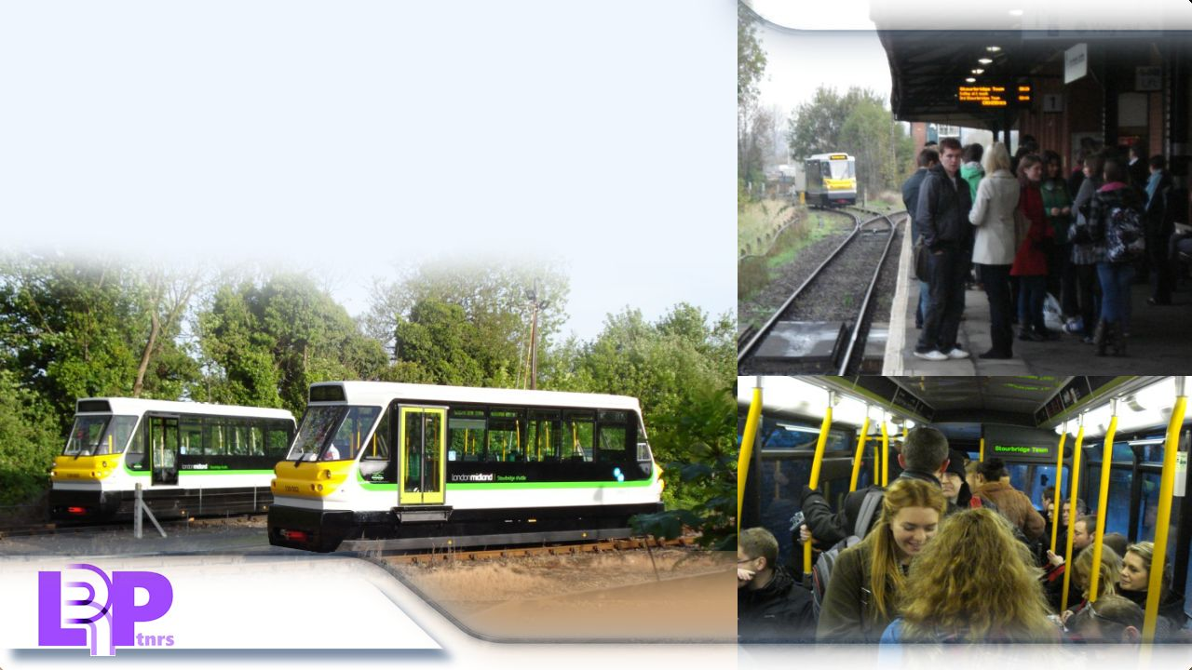
Slide 1: Introduction
TRAM TRAIN FORUM
PPM LIGHT RAIL TECHNOLOGY AS AN OPTION
LIGHT RAIL UK ON BEHALF OF THE ALL PARTY PARLIAMENTARY LIGHT RAIL
GROUP- LEEDS TOWN HALL 12TH DECEMBER 2016
The PPM60 is an innovative but well-proven, economical, low carbon and
Popular 60 passenger rail vehicle in branch line service in the West Midlands
Since May 2009.
on behalf of

Slide 2
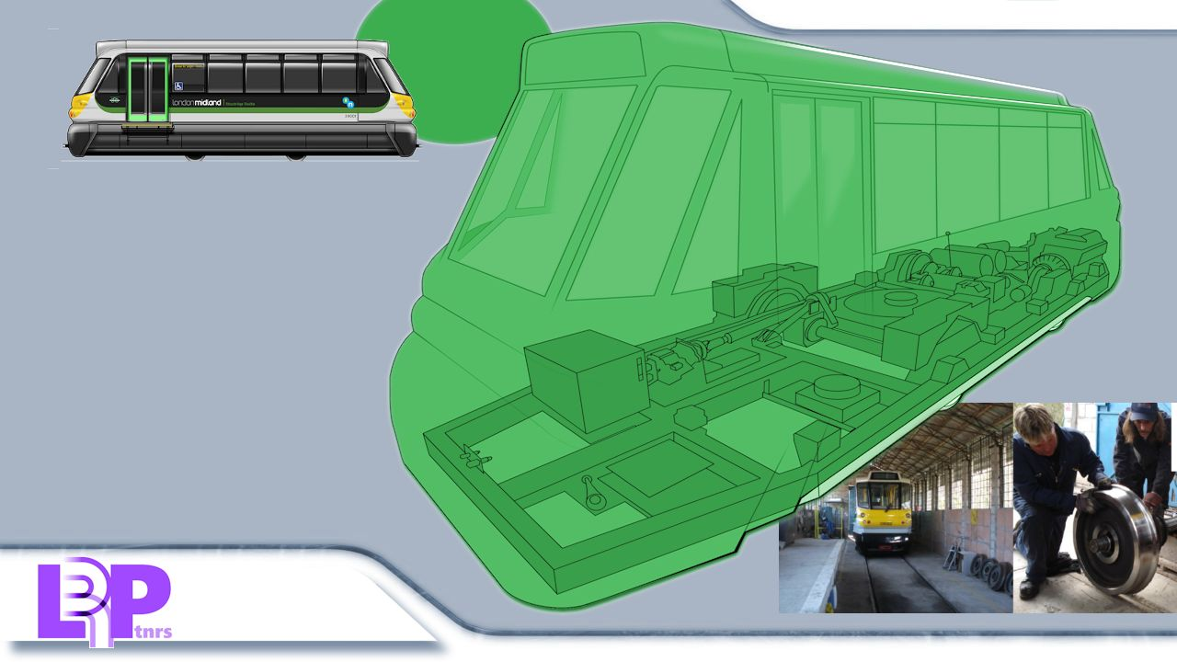
Slide 2: PPM60 / Class 139 Specification
PPM60/
Class 139
CLASS 139 HYBRID LIGHT RAILCAR CURRENT
SPECIFICATION :-
Patented flywheel hydrostatic traction.
Bus & Coach technology bodywork.
Vehicle floor and boarding platform at
same levels.
Light tare axle weight (around 5t)
End cross section of a typical road
Vehicle ie. Single deck bus.
6. Maintainable in low cost automotive
Style facilities, standard tools and skills.
Top speed 35mph.
Acceleration and braking capability of a
street tram, can run on LPG or CNG.*
*Natural
gas from the
domestic supply main.
on behalf of

Slide 3
Slide 3a: Operating Company Background
2016: Pre Metro Operations was Highly Commended in the ‘Operator of the Year’ category at the Global Light Rail Awards, coming second only to Manchester’s Metrolink tram network.
PMOL OPERATING RECORD
The specialist train operating company Pre Metro Operations Limited has had an exemplary record operating the Shuttle train service at Stourbridge using Class 139 railcars. Passenger numbers have grown year on year.
on behalf of

Slide 4
Slide 3b: Operating Company Background
2016: Passenger Numbers Continue to Grow:
PMOL OPERATING RECORD
The specialist train operating company Pre Metro Operations Limited has had an exemplary record operating the Shuttle train service at Stourbridge using Class 139 railcars. Passenger numbers have grown year on year.
on behalf of
*
*First half annualised

Slide 5
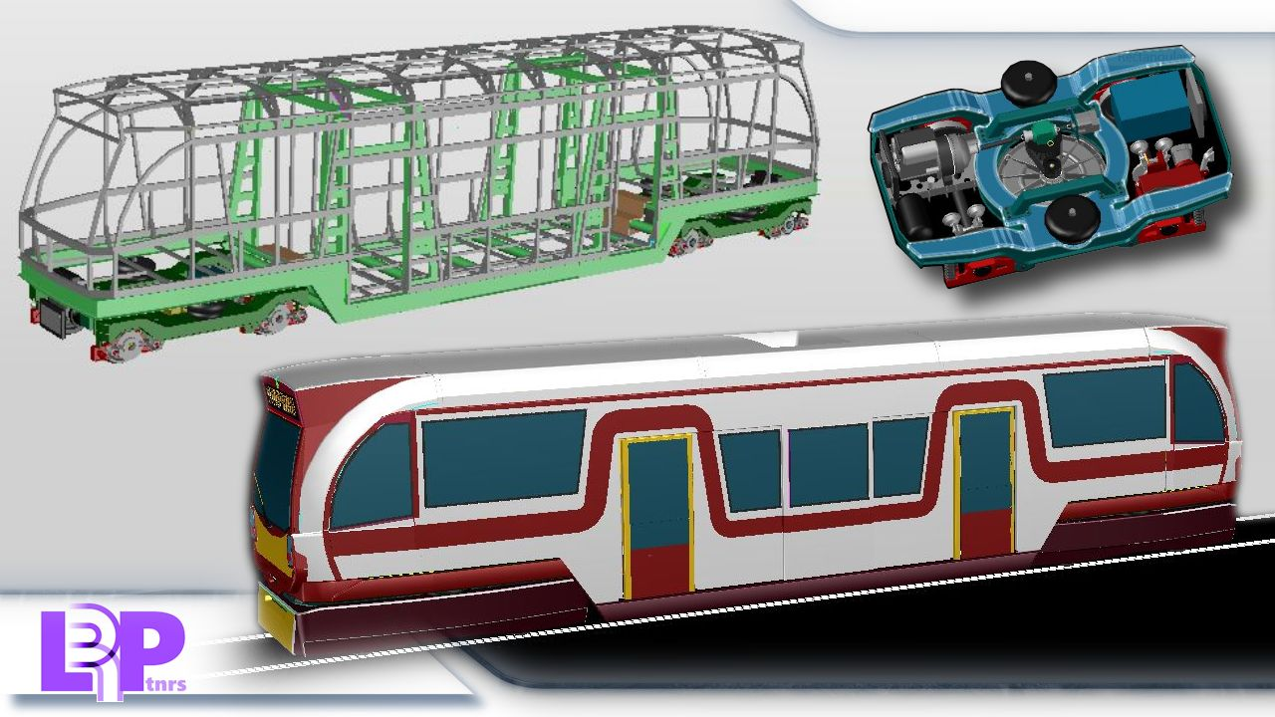
Slide 4: Stretched Version for Leeds
STRETCHED VERSION
OF PPM RAILCAR FOR
90 PASSENGERS
WITH ON STREET
CAPABILITY
on behalf of

Slide 6
Slide 5: Manufacturing Collaboration
on behalf of

Slide 7
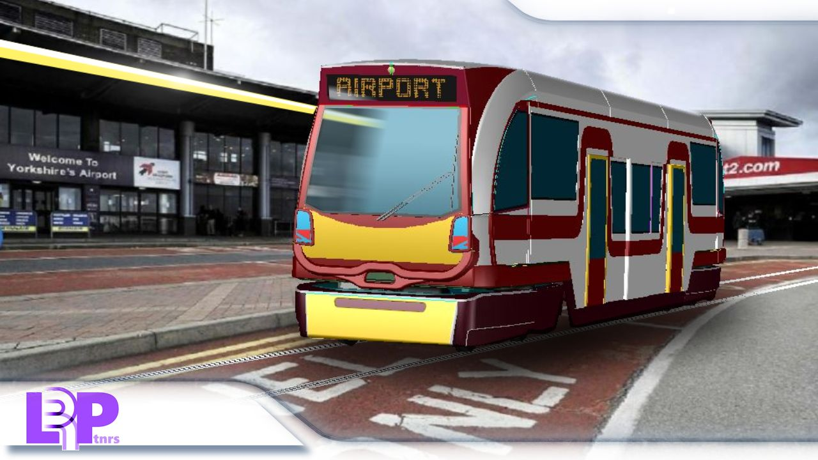
Slide 6a: Summary
WHO NEEDS AN AFFORDABLE TRAM TECHNOLOGY?
External authorities in Britain are encouraging the development of a stretched, 90 passenger, 50mph Tram-Train, the PPM-Clayton ‘Compact 90’.
*DfT Rail
*UKTram
*TfWM (the West Midlands local transport authority)
Rail patronage is experiencing unprecedented levels of demand. Suburban trains are getting overcrowded carrying more passengers than even in the peak years between the two World Wars.
A revival of tramways (Light Rail) began 30 years ago but until now these are only carrying 5% of the passenger numbers of the years between the wars.
MIGHT LEEDS BE ONE OF THE PIONEERS IN THE DRIVE FOR
A MORE AFFORDABLE FORM OF TECHNOLOGY BASED ON
TRAM TRAINS ABLE TO OPERATE WITHOUT NEEDING
ELECTRIFICATION OF THE TRACK?
on behalf of

Slide 8
Slide 6b: Summary
on behalf of

